Slide 1

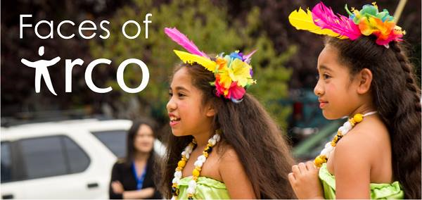
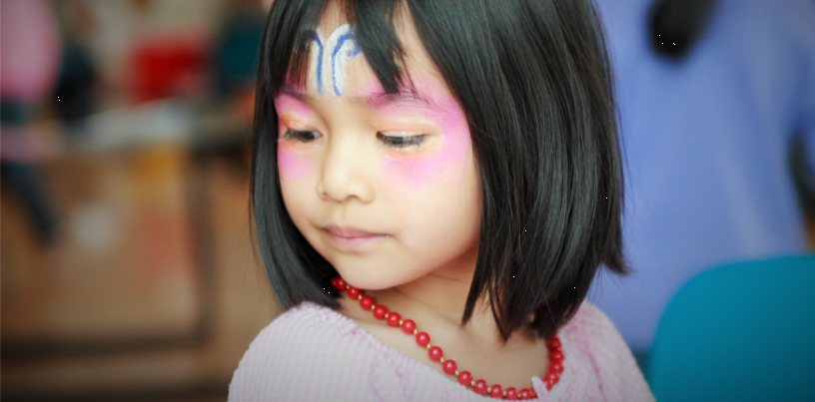
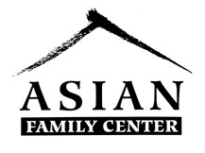
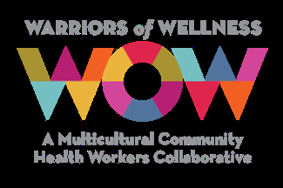
Community Health Worker
WOW Project
WHAT’S WOW:
The​ ​Warriors​ ​of​ ​Wellness​ ​(WOW)​ ​Collaborative​ ​is​ ​a​ ​model​ ​created​ ​in​ ​2014​ ​through​ ​which healthcare​ ​organizations​ ​can​ ​contract​ ​for​ ​culturally-specific​ ​community​ ​health​ ​worker​ ​(CHW) services​ ​through​ ​local​ ​community-based​ ​organizations​ ​(CBOs)​ ​to​ ​improve​ ​the​ ​health​ ​of​ ​their members​ ​while​ ​improving​ ​health​ ​equity.​ ​Culturally​ ​specific​ ​CHW​ ​program​ ​services​ ​include one-on-one​ ​support​ ​and​ ​health​ ​education,​ ​health​ ​care​ ​navigation,​ ​community​ ​organizing,​ ​group classes,​ ​and​ ​cultural​ ​mediation​ ​among​ ​other​ ​services.
SERVICES PROVIDED
​health​ ​promotion​ ​activities​ ​to support​ ​individuals​ ​and​ ​communities​ ​to​ ​prevent​ ​and​ ​manage​ ​chronic​ ​diseases​ ​and increase​ ​access​ ​to​ ​social​ ​and​ ​health​ ​care​ ​services
Case management, home visits and referrals
Host​ ​health​ ​services/screenings​ ​in​ ​community​ ​settings​ ​(schools,​ ​places​ ​of​ ​faith, community​ ​centers,​ ​etc.),​ ​including​ ​hearing,​ ​vision,​ ​dental,​ ​and​ ​immunization​ ​to increase​ ​awareness​ ​and​ ​access​
Please contact your community health worker for more info
Zaharah Adam
IRCO- Asian Family Center
8040 NE Sandy Blvd Portland, OR 97213
T:503-235-9396
E-mail:Zaharaha@irco.org
Notes:
IRCO’s mission is to promote the integration of
refugees, immigrants and the community at large
into a self-sufficient, healthy and inclusive
multi-ethnic society.
Founded in 1976 by refugees for refugees, IRCO has over 40 years of history and experience working with Portland's refugee and immigrant communities. Following the 1970s political upheavals in Southeast Asia, Oregon and Washington were two of the first states to offer new opportunities and homes to refugees. A group of Vietnamese, Laotian and Cambodian refugees in Portland formed the Indochinese Cultural and Service Center (ICSC) to help newly arrived families adjust to American society and find jobs.
By the mid-'80s, ICSC joined forces with another community-based organization, Southeast Asian Refugee Federation (SEARF). The newly formed International Refugee Center of Oregon (IRCO) became the sole service provider of employment services and job training for all newly arrived refugees, a role IRCO has retained ever since. We became the Immigrant and Refugee Community Organization in 2001.

